Slide 1
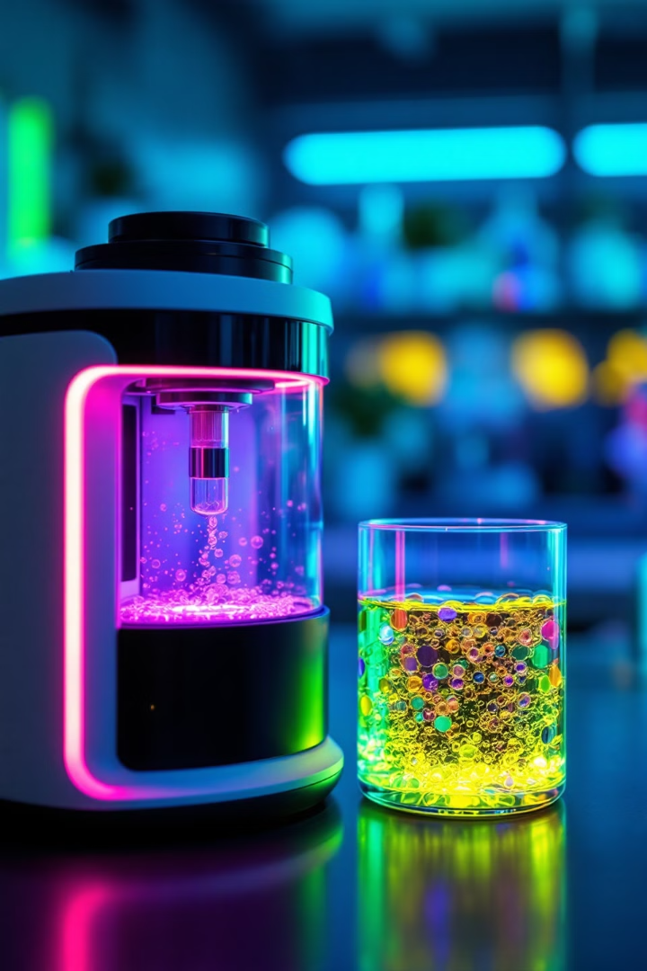
Transforming “Cell Counting”
Through Automation
- Labro Inc.
Welcome to Labro Inc., where we're revolutionizing laboratory workflows with cutting-edge automation technology. Our focus on precision, efficiency, and innovation is reshaping the future of cell counting, empowering researchers and scientists to achieve more accurate results in less time.

Slide 2
Biotech Industry “Cell Counting” Challenges Today
545K
200K
Time-Consuming Process
- Lack of Adaptability
Human Error Risk
- High Operational Costs
Sterility Concerns
- Poor Integration
US Researchers
Hours Weekly
Sciences professionals impacted
Time spent on manual cell counting
$312M+
20%
Annual Impact
Error Rate
Potential productivity savings
Resource waste, and inconsistent results
source: CBRE

Slide 3
Market Opportunity
Labro Inc. is poised to tap into a significant market opportunity in the laboratory automation sector.
Our target market encompasses a diverse range of research institutions and companies,
presenting a substantial potential for growth and revenue generation.
172K
5 - 10
Total laboratories in our target market
Average number of devices per laboratory
$1.29B - $2.58B
$129M - $258M
Total revenue for full market
Projected total revenue for 10% of the market - entry level
source: Link + Link2
Notes:
Our target market is segmented into four key categories: Research Universities (40%), Biotech Companies (35%), Medical Centers (15%), and Other Research facilities (10%). This diverse customer base ensures a robust and stable market for our innovative laboratory automation solutions.
With an initial hardware market potential of $13 million at full penetration and an annual recurring revenue projection of $3.77 million, Labro Inc. is well-positioned for substantial growth. A detailed 5-year growth projection is available, demonstrating our long-term vision and potential for sustained success in this dynamic market.
5-10个每lab 1.5k刀

Slide 4
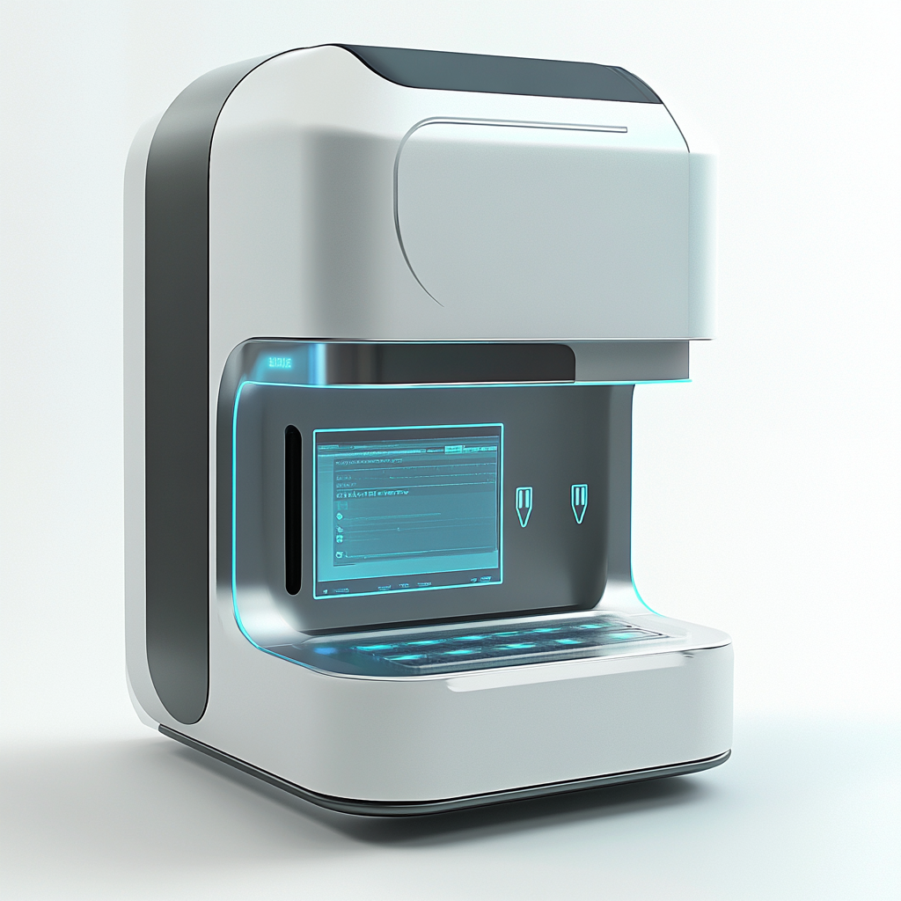
Our Solution: Automated Cell Counter
Auto Sample Setting
Auto Mixing
Auto Focus
Auto Cell Count
Validation results from pilot users have been overwhelmingly positive, demonstrating a significant 60% time savings and achieving an impressive 95%+ accuracy rate. These results underscore the transformative potential of our solution in revolutionizing laboratory workflows.
Notes:
Our target market is segmented into four key categories: Research Universities (40%), Biotech Companies (35%), Medical Centers (15%), and Other Research facilities (10%). This diverse customer base ensures a robust and stable market for our innovative laboratory automation solutions.
With an initial hardware market potential of $13 million at full penetration and an annual recurring revenue projection of $3.77 million, Labro Inc. is well-positioned for substantial growth. A detailed 5-year growth projection is available, demonstrating our long-term vision and potential for sustained success in this dynamic market.
5-10个每lab 1.5k刀

Slide 5
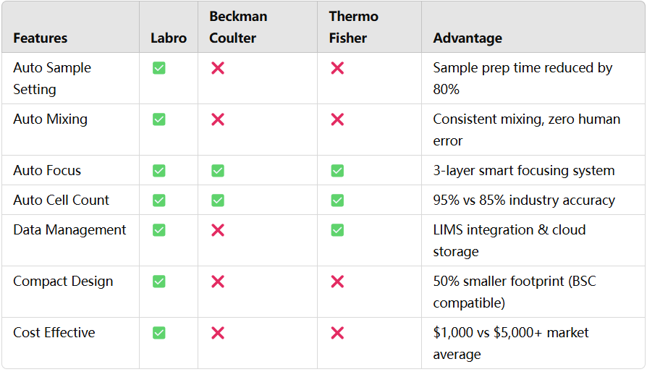
Competitive Advantage: Our Key Differentiators
Notes:
Our target market is segmented into four key categories: Research Universities (40%), Biotech Companies (35%), Medical Centers (15%), and Other Research facilities (10%). This diverse customer base ensures a robust and stable market for our innovative laboratory automation solutions.
With an initial hardware market potential of $13 million at full penetration and an annual recurring revenue projection of $3.77 million, Labro Inc. is well-positioned for substantial growth. A detailed 5-year growth projection is available, demonstrating our long-term vision and potential for sustained success in this dynamic market.
5-10个每lab 1.5k刀

Slide 6
Intellectual Property
At Labro Inc., we've built a robust intellectual property foundation to protect our innovative technologies and maintain our competitive edge in the laboratory automation market.
1
Automated Processing Technology
2
Miniaturized Design
3
Data Processing Algorithm
4
Optimized Consumables
5
UI/UX Integration System

Slide 7
Revenue Model
Device Package Revenue : $1,500 / unit
Recurring Revenue : $500 / unit / year
Hardwear x 1 unit
Consumables accessories : $200 / unit / year
3-year warranty included
Technology on call Support: $300 / unit/ year
Data Services: Custom pricing
$100
$200
$150
Manufacturing Cost / unit
Operating Cost / unit
Consumables & Service Cost / unit / year
86%
70%
Device Package Profit Margin / unit
1300/1500*100%=86%
Consumables & Service Profit Margin / unit / year
350/500*100%=70%
Notes:
Our cost structure is designed to balance fixed investments with variable costs, ensuring scalability and profitability. We've strategically allocated resources to key areas like mold development and marketing campaigns, while maintaining efficient manufacturing and operating costs. Our diverse revenue streams, including hardware, consumables, and services, offer attractive profit margins that contribute to our overall financial health and growth potential.

Slide 8
Financial Projections
Year | 2025 | 2026 | 2027
Units Sold | 2000 | 5000 | 10000
Total Revenue | $4,000,000.00 | $10,000,000.00 | $20,000,000.00
Total Costs | $1,150,000.00 | $2,500,000.00 | $4,750,000.00
Gross Profit | $3,100,000.00 | $7,750,000.00 | $15,500,000.00
Operating Profit | $2,850,000.00 | $7,500,000.00 | $15,250,000.00
Net Profit | $2,137,500.00 | $5,625,000.00 | $11,437,500.00
Net Cash Flow | $1,437,500.00 | $5,625,000.00 | $11,437,500.00
Notes:
Our cost structure is designed to balance fixed investments with variable costs, ensuring scalability and profitability. We've strategically allocated resources to key areas like mold development and marketing campaigns, while maintaining efficient manufacturing and operating costs. Our diverse revenue streams, including hardware, consumables, and services, offer attractive profit margins that contribute to our overall financial health and growth potential.

Slide 9
Go-to-Market Strategy
Direct Channel
-Digital marketing
-Scientific conferences
-Direct sales team
Partnerships
-Equipment distributors
-Research institutions
-Industry influencers
Market Awareness
-Workshops and demos
-Support scientific publications
- Peer-to-peer learning and support.
Target Customers
-Pharmaceutical companies conducting clinical trials
-Labs studying cell behavior under environmental changes
- Diagnostic labs requiring precise cell counts
Notes:
简短
把我们公司的background international company
世界地图办公室位置
Go-to-Market Channels
Local Distributors: Specialized in lab equipment.
Direct Sales: Targeting pharmaceutical companies and research labs.
Scientific Conferences: Engaging with biotech and clinical professionals.
Target Customers
Pharmaceutical companies conducting clinical trials.
Labs studying cell behavior under environmental changes.
Diagnostic labs requiring precise cell counts.

Slide 10
Business Development Strategy
Phase 1: Market Entry
Phase 2: AI Innovation
Phase 3: Tech Solution
Northeast US Research Corridor focus
Achieve national coverage
Enter international markets
Establish key academic partnerships
Concentrate on AI and biotech sector
Transfer into a tech consulting company
Target initial 10% market share
Aim for 20-40% market share
Introduce enterprise solutions

Slide 11
Core Management
CEO
Quincy Wang
COO
Gianna Zhan
CBD0
Lin Ackerman
CTO
Subbir Parvej
CMO
Chris Zhang

Slide 12
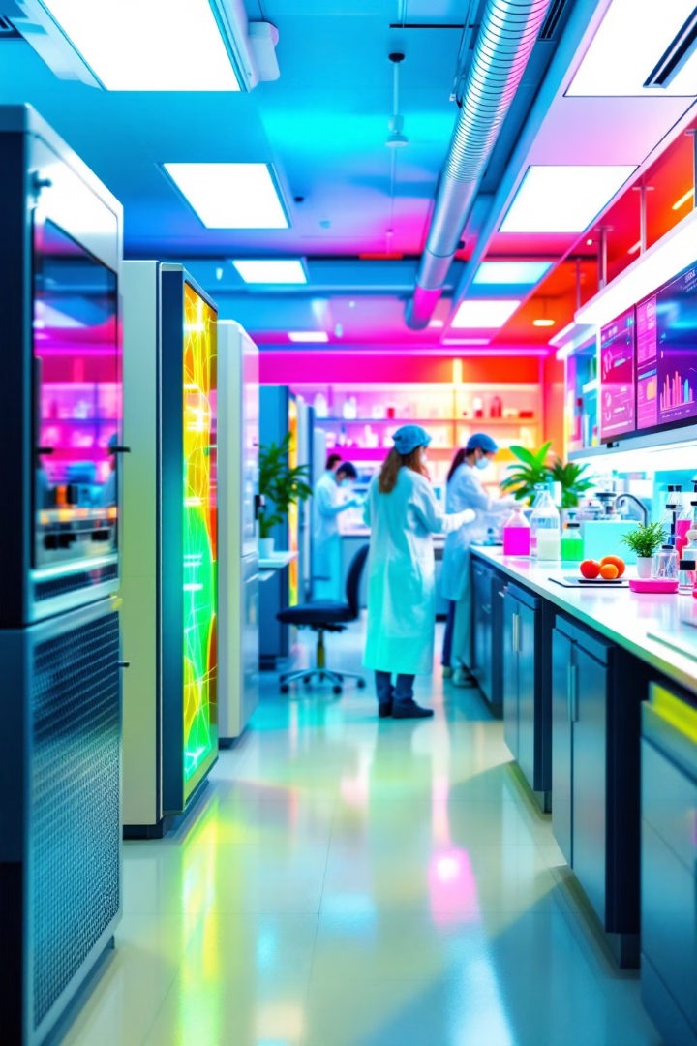
Contact Us for Revolutionary Lab Solutions
Email : quincy@labro.info
Call : 571-325-9342
Office : 21 W Sunnyside Way, Troy, NY 12180
Thank you for your interest in Labro Inc. We're excited about the opportunity to revolutionize laboratory workflows and transform cell counting through automation. Our innovative solution is poised to address critical challenges in today's laboratories, offering significant improvements in efficiency and accuracy.
Ready to learn more about how Labro Inc. can benefit your laboratory? We'd love to hear from you. Reach out to discuss our automated cell counting technology, investment opportunities, or any questions you may have about our transformative approach to laboratory processes.

